Slide 1
Announcements
Please do not use AI to complete your labs
If you need help, ask me - I am literally paid to help you anyway I can short of giving you the answer
You can ask me in class, via email, or come to my office hours
Tuesday the 28th and Wednesday the 29th are for make up labs
All other labs need to be in by Monday the 27th
If you are going to makeup a lab, it must be one you were absent for, and you must let me know in advance
If nobody lets me know, I will not be here

Slide 2
Open Clusters

Slide 3
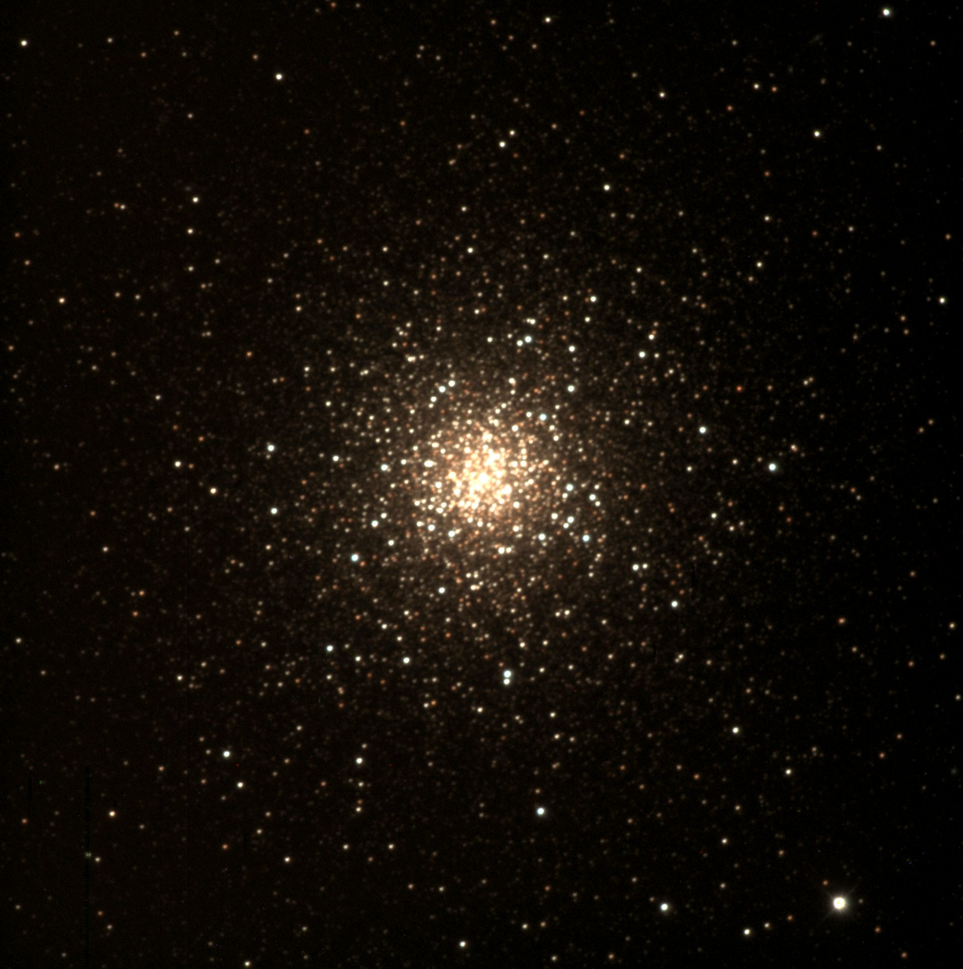
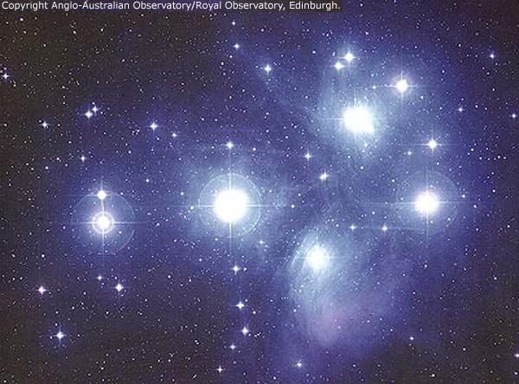
Types of Star Clusters
Globular Clusters:
Old
Dense
10,000s to 100,000s of stars
Located in the Galactic Halo
No gas or dust (all used up)
Open Clusters (What we are doing today):
Young
Loose
100s to 1000s of stars
Located in the Galactic Disk
Some gas and dust too
But a lot of the stuff we are doing today with Open Clusters can also be applied to Globular Clusters

Slide 4
Star Clusters
All stars in a cluster formed at the same time from the same cloud of dust and gas
Stars in a cluster are all the same age
More massive stars die faster than less massive stars
Blue stars are hotter and more massive
Last a few million years
Red stars are cooler and less massive
Last potentially trillions of years
The Sun is in between at around 10 billion years
Biggest to smallest: O, B, A, F, G, K, M
One Boring Afternoon Frank Grew Killer Marijuana

Slide 5
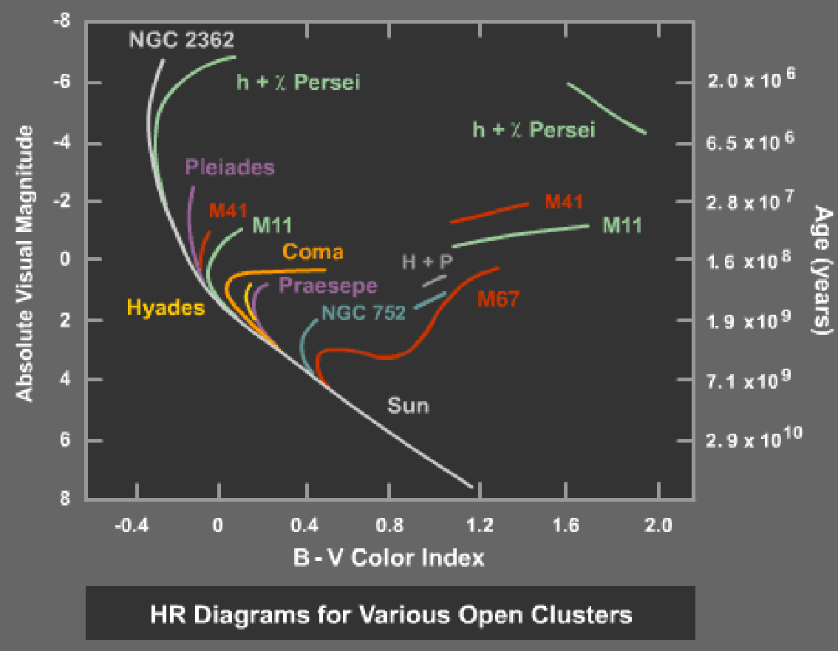
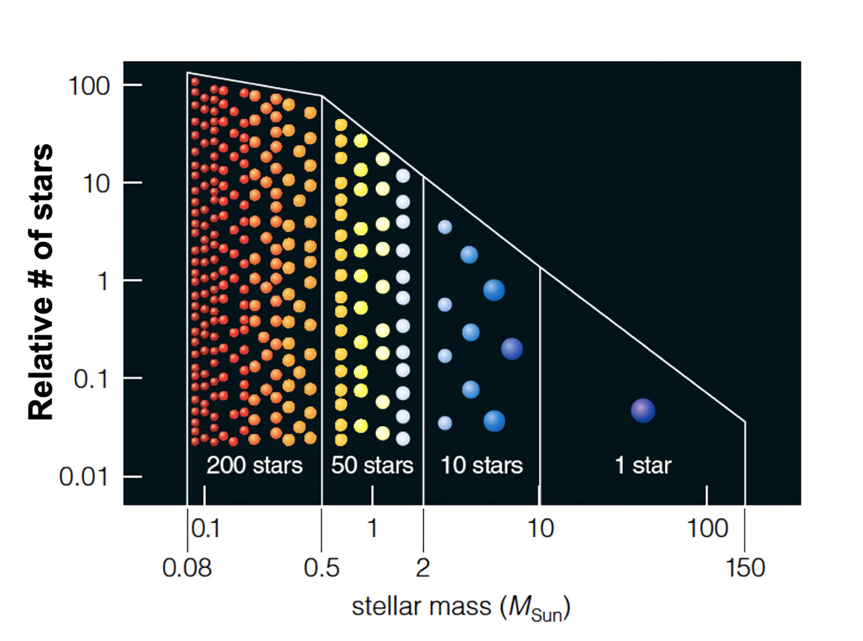
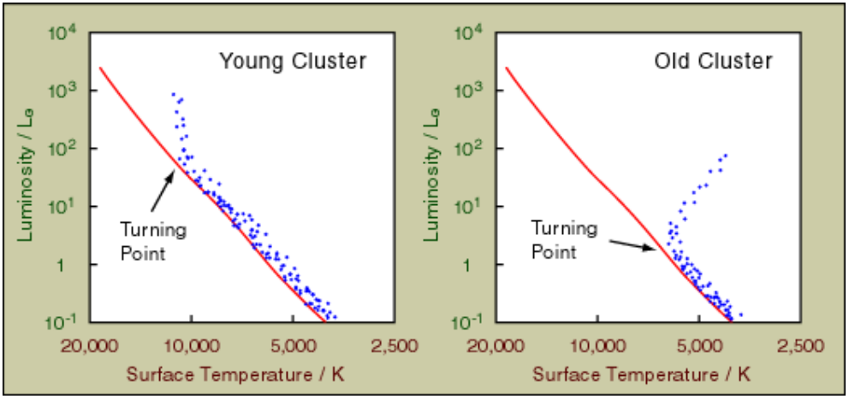
Star Clusters Cont.
When a star cluster forms, we see a lot of little stars, and only a few really big stars
The big stars then die faster, leading to:
↑ Important: This is Figure 4 from your lab script

Slide 6

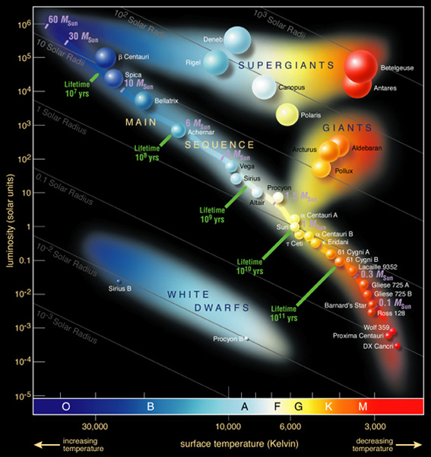
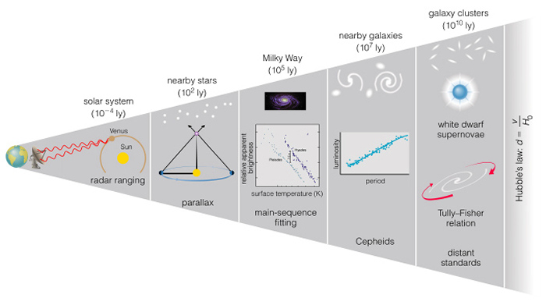
Finding Distance With the Main Sequence (First, A Quick Review)
Fafwefwegwrwr → “Distance Modulus” Note that your lab uses V and Mᵥ f sdvsdvvasdadzdvsdv instead of m and M

Slide 7
Finding Distance With the Main Sequence
Overlay HR diagrams with apparent and absolute magnitude
Align the axes, then slide up and down so that the main sequences are aligned
-4
Main Sequence
Plug the magnitudes into the distance modulus
M = -4, m = 6
d = 10^((6 + 4 + 5)/5)
d = 1000 pc
Absolute Magnitude
6
Apparent Magnitude
Color

Slide 8
Today:
Grab a transparency, the data, and some dry-erase markers
Graph the stars from Table 1 on Page 7 on the transparency
Note that Table 1 has two columns - so you will need a total of 14 stars
I recommend drawing a line (not necessarily straight) through them to make it easier to see the Main Sequence
Place your transparency over the data
Line up the vertical axes, then move up or down so that the main sequences are on top of eachother
Choose 3 points on the main sequence
For each point, subtract V-Mᵥ and write it on Table 2 (page 8)
Take the average of those 3 and use that to determine the distance (also put it on Table 2)
Then find the Turn-Off Point and record it on Table 2
Compare to figure 4 in your lab script to estimate the age (also put it on Table 2)
I have the “actual” distances on the board
Record them on Table 2 and calculate the percent difference with your calculated distance

